Slide 1
Golang:Net package
24/01/2023

Slide 2
Golang: Important packages
Crypto
Compress
Database
Debug
Encoding
Syscall
testing
Net
context
2

Slide 3
Golang: net package..
Working with net package
net provides a portable interface for network I/O
Supports tcp/udp name resolution
Supports Unix domain sockets
Package provides low level network primitives
However, Go app developers need very basic interfaces
Dial
Listen
Accept
3

Slide 4
Golang: net package
Dial
The Dial function connects to a server
func Dial(network, address string) (Conn, error) Conn
func DialTimeout(network, address string, timeout time.Duration) (Conn, error) Conn
Dial, DialTimeOut can work with both tcp and udp
4

Slide 5
Golang: net package
Dial
conn, err := net.Dial("tcp", "127.0.0.1:1234") if err != nil { // handle error }
fmt.Fprintf(conn, "GET / HTTP/1.0\r\n\r\n") status, err := bufio.NewReader(conn).ReadString('\n') // ...
5

Slide 6
Golang: net package
Listen
Listnen function listen for a network connection
func Listen(network, address string) (Listener, error)
Connects to address string and network protocol
6

Slide 7
Golang: net package
Listen
ln, err := net.Listen("tcp", ":8080") if err != nil { // handle error } for { conn, err := ln.Accept() if err != nil { // handle error } go handleConnection(conn) }
7

Slide 8
Golang: net package
Listen
Listnen function listen for a network connection
func Listen(network, address string) (Listener, error)
Connects to address string and network protocol
8

Slide 9
Golang: net/http package
http
Http is an application layer protocol and works in client and server mode
Http server is a program running on a machine
It listens and responds to HTTP requests on a specific ip and port
Http works in request and response
9

Slide 10
Golang: net/http package
http
Http server components
Request – it defines the request parameters i.e, Method, Api Signature, request headers, body, query params etc
Response – defines the response parameters i.e, Status code, response body, headers
Each API signature corresponds to a handler
Mux is router
Listener – It runs on the machine, which listens to a particular port.
On receiviing request on that port it forwards the request to the mux
10

Slide 11
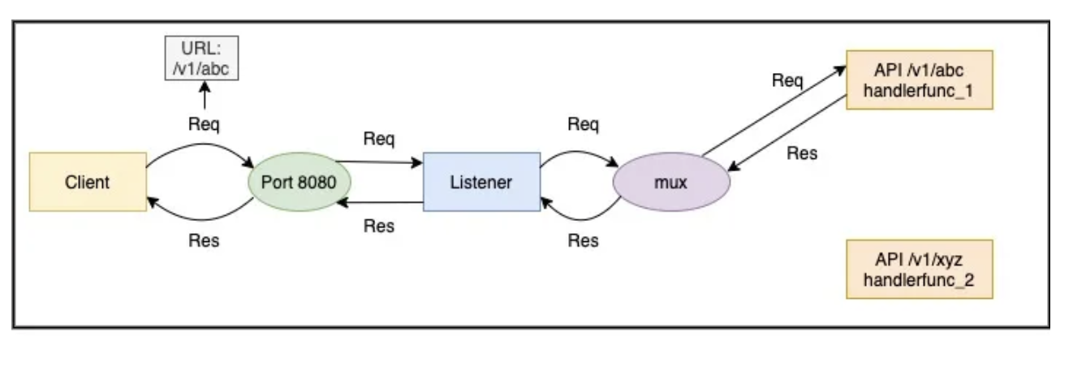
Golang: net/http package
http
/v1/abc and handlerfunc_1 and /v1/xyz and handlerfunc_2
11

Slide 12
Golang: net/http package
Http request
A request is represented by the Request Struct (https://golang.org/pkg/net/http/#Request)
It contains the
request method,
Api Signature,
request headers,
body,
query params
12

Slide 13
Golang: net/http package
Http response
A response is represented by the ResponseWriter Interface (https://golang.org/pkg/net/http/#ResponseWriter)
ResponseWriter interface is used by an HTTP handler to construct an HTTP response
It provides three functions to set the response parameters
Header – For writing response header
Write([]byte) – For writing response body
WriteHeader(statusCode int) – For writing the http status code
13

Slide 14
Golang: net/http package
API Signature and Handler
API signature and its handler are paired
Handler is called by the mux when it receives an API call matching the API signature
A golang handler can be either a function or a type
type Handler interface { ServeHTTP(ResponseWriter, *Request) }
func(ResponseWriter, *Request)
14

Slide 15
Golang: net/http package
Mux
mux route request to the registered handler based upon API signature
If the signature and its handler is not registered with the mux, it raises a 404
Go provides a default mux built in the language
There are mux available from third party as well
Gorilla mux and fiber
Create Mux
mux := http.NewServeMux()
mux.HandleFunc(pattern, handlerFunc)
mux.Handle(pattern, handler)
15

Slide 16
Golang: net/http package
Mux
mux route request to the registered handler based upon API signature
If the signature and its handler is not registered with the mux, it raises a 404
Go provides a default mux built in the language
There are mux available from third party as well
Gorilla mux and fiber
Create Mux
mux := http.NewServeMux()
mux.HandleFunc(pattern, handlerFunc)
mux.Handle(pattern, handler)
16

